Slide 1

Microsoft Azure
Presented by Brian

Slide 2

CI / CD
What Azure resources can we use to set up and implement CI / CD in our work environment?

Slide 3
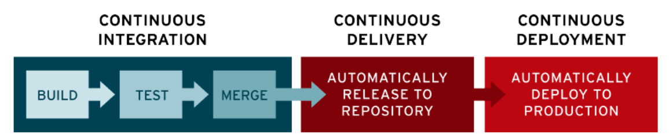
What is CI / CD
CI (continuous integration) is a modern software development practice in which incremental code changes are made frequently and reliably
CD (continuous delivery) is the automated delivery of completed code to environments like automated testing.
CD (continuous deployment) deploying polished code to production.
CI = writing code, CD = testing and deploying finished code.

Slide 4
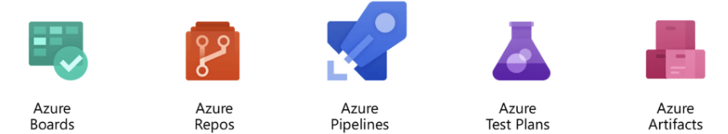
Azure Resources for CI / CD
Azure DevOps:
Azure Boards: plan, track, and discuss work across your teams
Azure Repos: like GitHub, but targets private project repositories
Azure Pipelines: build, test, and deploy to Azure platforms automatically
Azure Test Plans: plan, execute, and track scripted tests
Azure Artifacts: create and share code and packages with your team

Slide 5
Azure Redis Cache
What are two different ways to use Azure Redis Cache?

Slide 6
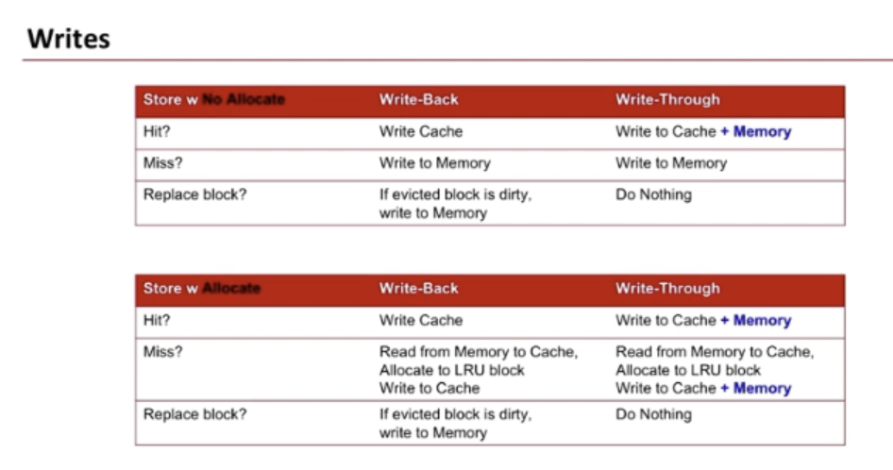
Method 1: Data Cache
Entire databases take longer to access than caches, and it takes too much space to load all the data in databases into a cache.
We can use caches to speed up data access by storing recently used data and using different eviction policies:

Slide 7
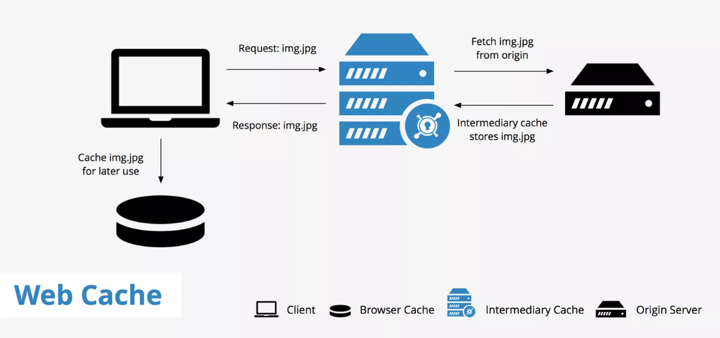
Method 2: Content Cache
Many web pages are generated from templates that use static content such as headers, footers, banners.
These static items shouldn't change often, so using an in-memory cache provides quick access to static content compared to backend datastores.

Slide 8
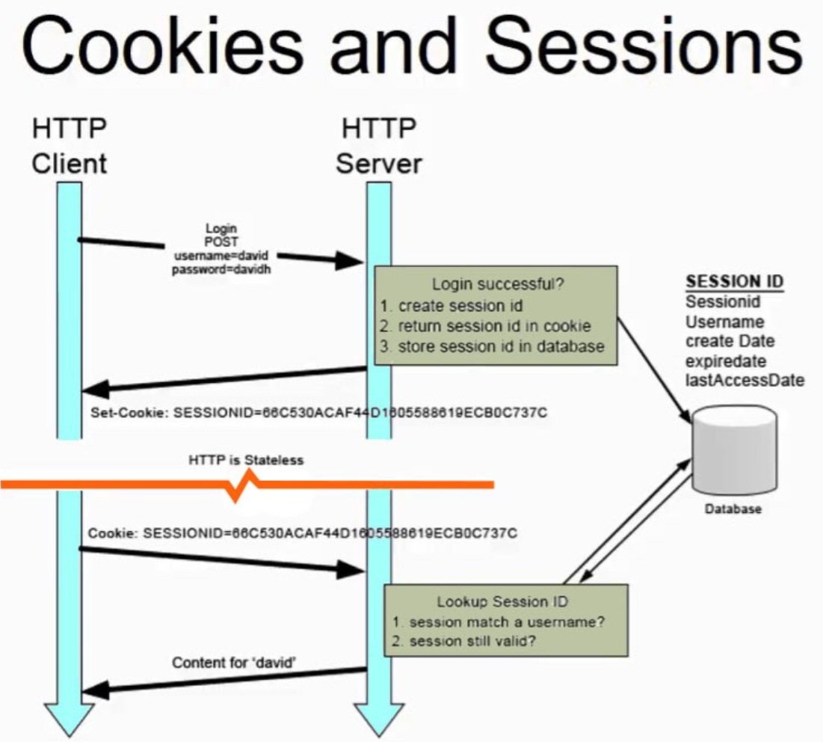
Method 3: Session Store
Ex: shopping carts, user history data associated with user cookies.
Storing too much data in a cookie negatively effects browser performance. Typical browsers use the cookie as a key to query the data in a relational database, but that’s too slow.
Using an in-memory cache, like Azure Cache for Redis, to associate information with a user is much faster.

Slide 9
Application Insights
We want to monitor our application and collect metrics such as service availability and API response times. How can we do that?

Slide 10
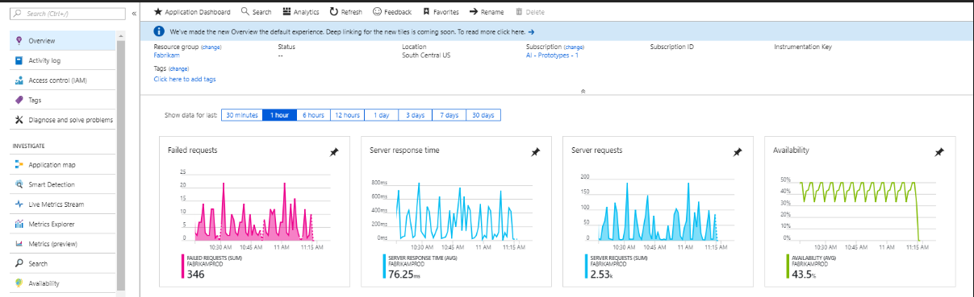
Application Insights
Application Insights can monitor Azure cloud service apps for availability, performance, failures, and usage by combining data from Application Insights SDKs with Azure Diagnostics data from your cloud services.

Slide 11
Azure Key Vaults
What are some ways to get these confidential values without hardcoding them into our application?

Slide 12
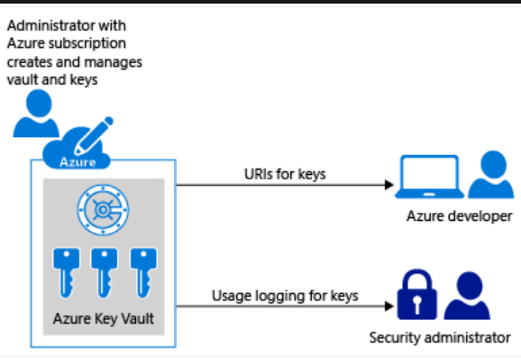
Azure Databases
Key vaults can be used to store a variety of private information:
A Secret is a small data blob (up to 10 KB in size) used in the authorization of users/applications with the help of a Key Vault.
Key Vault helps in mitigating the risk associated with the storage of secrets in a non-secure location.
Examples of secrets include: ssh authentication keys, storage account keys, passwords, tokens, API keys, email passwords, etc.

Slide 13
Azure Databases
Our application needs a data store. What are some options we can use and what are some advantages / disadvantages?

Slide 14
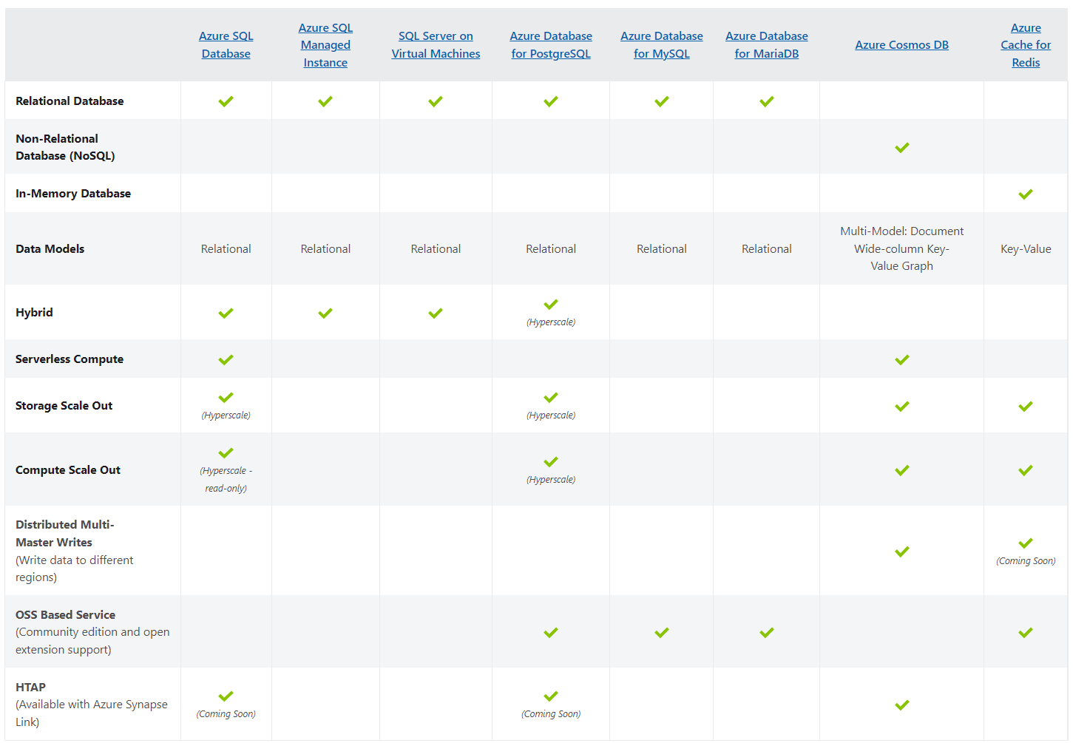

Slide 15
Azure Database for PostgreSQL
Pros:
High Availability (high redundancy, average down time of 4.38 hours / year)
Data Security
Scalability (turn computing power up or down with just a click)
Cost-Effective (pay what you use)
Cons:
Requires Platform Expertise (need experts to develop and monitor services on the Azure cloud)

Slide 16
Availability Zone
You plan to deploy several Azure virtual machines. You need to ensure that the services running on the virtual machines are available if a single data center fails. What settings should you do?

Slide 17
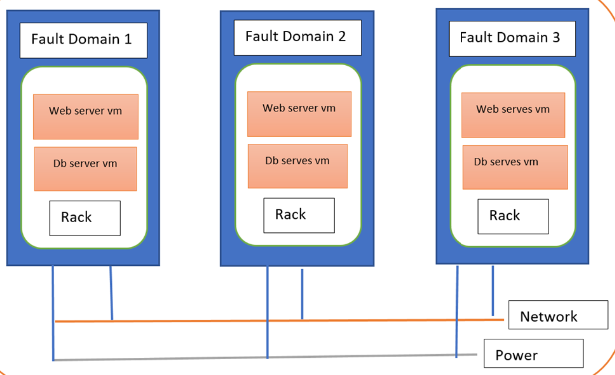
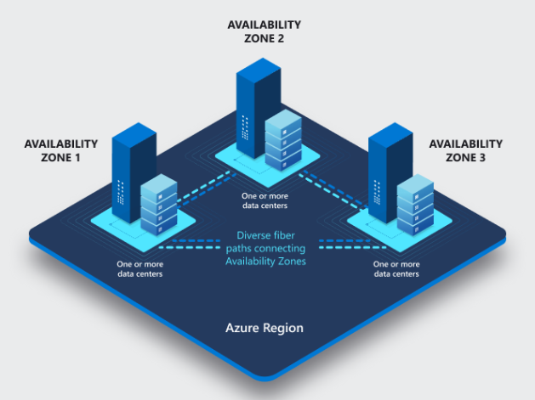
Azure VM Availability Zone
Availability Set
An Availability Set distributes highly available workloads across multiple Fault Domains, thereby eliminating any single point of failure.
Fault domains define the group of virtual machines that share a common power source and network switch.
Availability Zone
While availability sets are used to protect applications from hardware failures within an Azure data center, availability zones, protect applications from complete Azure data center failures.

Slide 18
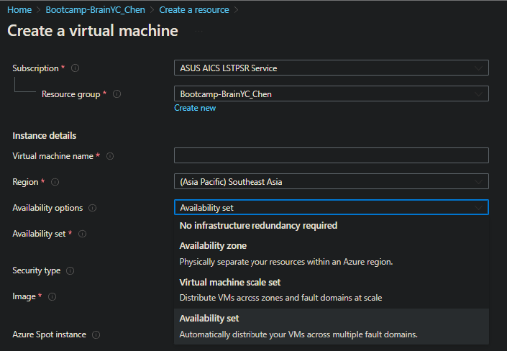

Slide 19
Azure App Service
What is Azure app service plan? What can be set via app service plan?

Slide 20
Azure App Service
Azure app service allows you to quickly and easily create enterprise-ready web and mobile apps for any platform or device, and deploy them on a scalable and reliable cloud infrastructure.
What you can set with App Service:
Operating System (Windows, Linux)
Region (West US, East US, etc.)
Number of VM instances
Size of VM instances (Small, Medium, Large)
Pricing Tier
The pricing tier of an App Service plan determines what App Service features you get and how much you pay for the plan.

Slide 21
App Service Pricing Tier
The pricing tier of an App Service plan determines what App Service features you get and how much you pay for the plan.
Shared compute: Free and Shared, the two base tiers, runs an app on the same Azure VM as other App Service apps, including apps of other customers. These tiers allocate CPU quotas to each app that runs on the shared resources, and the resources cannot scale out.
Dedicated compute: The Basic, Standard, Premium, PremiumV2, and PremiumV3 tiers run apps on dedicated Azure VMs. Only apps in the same App Service plan share the same compute resources. The higher the tier, the more VM instances are available to you for scale-out.
Isolated: This Isolated and IsolatedV2 tiers run dedicated Azure VMs on dedicated Azure Virtual Networks. It provides network isolation on top of compute isolation to your apps. It provides the maximum scale-out capabilities.

Slide 22
App Service vs VM
What are the differences between Azure App Services and Azure Virtual Machines?

Slide 23
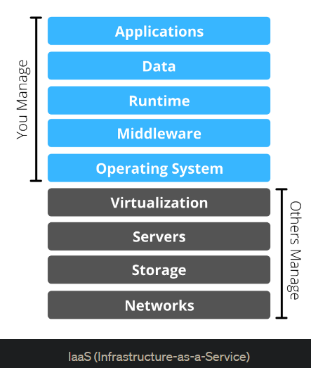
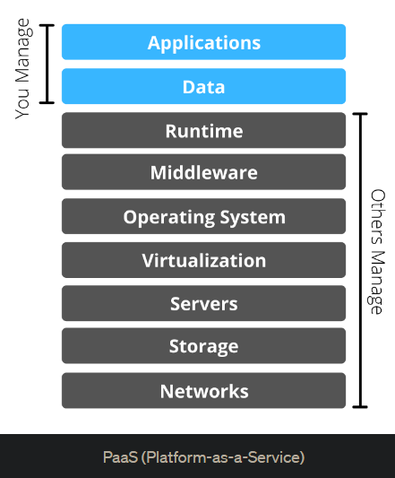
App Service vs VM
Azure Virtual Machine
Azure App Service

Slide 24
App Service vs VM
Azure Virtual Machine
d
much less managerial efforts
Azure App Service

Slide 25

The way to get started is to quit talking and begin doing.
Walt Disney

Slide 26
Timeline
Title
To start a presentation, go to the Slide Show tab, and select From Beginning.
Title
To display Presenter view, in Slide Show view, on the control bar at the bottom left select the three dots, and then Show Presenter View.
Title
During your presentation, the speaker notes are visible on your monitor, but aren't visible to the audience.
Title
Title
If you don’t see the Notes pane or it is completely minimized, click Notes on the task bar across the bottom of the PowerPoint window.
The Notes pane is a box that appears below each slide. Tap it to add notes.

Slide 27
Content
Subtitle
Subtitle
Add text, images, art, and videos.
Add transitions, animations, and motion.
Save to OneDrive, to get to your presentations from your computer, tablet, or phone.
Open the Design Ideas pane for instant slide makeovers.
When we have design ideas, we’ll show them to you right there.

Slide 28
Content 2
Subtitle
subtitle
subtitle
Add text, images, art, and videos.
Add transitions, animations, and motion.
Save to OneDrive, to get to your presentations from your computer, tablet, or phone.
Open the Design Ideas pane for instant slide makeovers.
When we have design ideas, we’ll show them to you right there.
Add text, images, art, and videos.
Add transitions, animations, and motion.
Save to OneDrive, to get to your presentations from your computer, tablet, or phone.
Open the Design Ideas pane for instant slide makeovers.
When we have design ideas, we’ll show them to you right there.
Add text, images, art, and videos.
Add transitions, animations, and motion.
Save to OneDrive, to get to your presentations from your computer, tablet, or phone.
Open the Design Ideas pane for instant slide makeovers.
When we have design ideas, we’ll show them to you right there.

Slide 29

Summary
With PowerPoint, you can create presentations and share your work with others, wherever they are. Type the text you want here to get started. You can also add images, art, and videos on this template. Save to OneDrive and access your presentations from your computer, tablet, or phone.

Slide 30


Thank You

